Slide 1
Intro to compute jobs
Jens Mueller, PhD
Miami University

Slide 2
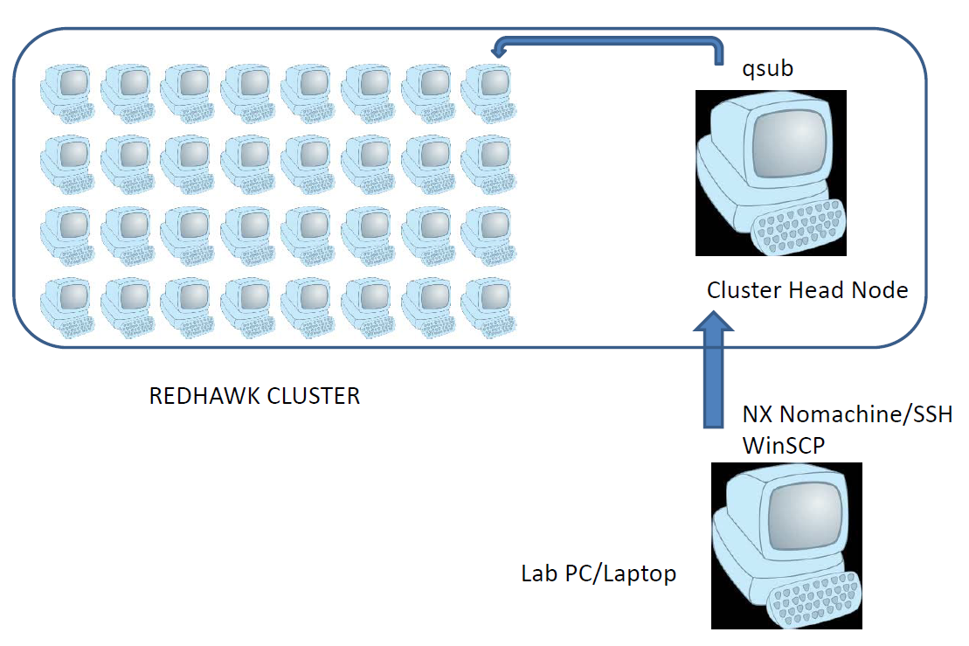
Intro to compute jobs

Slide 3
Resource manager/job scheduler
Multi-user environment requires intelligent allocation and management of resources
Needs to factor in that demand is higher than available resources
If higher demand than available resources but computations still (somehow) put into run status, resources would be overloaded
Redhawk uses Moab/Torque (PBS Portable Batch System)
Allows to make reservations for certain resources

Slide 4
Resources
Nodes
Compute cores
Memory
Specific types of nodes
Other hardware e.g. GPGPUs
Compute time (walltime)
Software licenses
Specific wait queues

Slide 5
Compute Job Design: Decision process
What are my computational requirements:
Software type (serial, multi-core, MPI parallel)
Time requirements (short, medium, long)
“Number of runs” requirement
What are available resources:
# of available nodes
# of cores
Limits on number of jobs per user
Time limits for jobs
Limits for memory
Limits for (temporary/permanent) storage

Slide 6
Compute Job Design: Decision process
Can I adapt my requirements to resources available?
Can I speed up processing by modifying my code?
Can I split my problem into smaller pieces?
Is there flexibility with respect to prioritizing my work, e.g. can I run more jobs than normally permitted?

Slide 7
Resource Monitoring
showq
Helps with making decisions on how many resources can be used at a given time
active jobs------------------------
JOBID USERNAME STATE PROCS REMAINING STARTTIME
106304 zanjanm Running 16 00:14:35 Fri Jul 24 09:55:49
106306 zanjanm Running 16 00:17:48 Fri Jul 24 09:59:02
106307 zanjanm Running 16 00:17:48 Fri Jul 24 09:59:02
106308 zanjanm Running 16 00:17:48 Fri Jul 24 09:59:02
105936 storera Running 12 6:22:42 Wed Jul 22 18:03:56
106311 ferrenam Running 8 8:04:54 Fri Jul 24 11:46:08
106313 ferrenam Running 8 8:14:07 Fri Jul 24 11:55:21
106317 webmo Running 1 8:18:18 Fri Jul 24 11:59:32
….
….
35 active jobs 413 of 768 processors in use by local jobs (53.78%)
20 of 32 nodes active (62.50%)

Slide 8
Resource Monitoring
showbf
Helps with making decisions on how many resources can be used at a given time
“Tasks” is cores
Partition Tasks Nodes Duration StartOffset StartDate
--------- ------ ----- ------------ ------------ --------------
ALL 343 19 INFINITY 00:00:00 13:45:45_07/24

Slide 9
Resource Monitoring – Advanced With qmgr
[muellej@mualhplp01:Ex_2] $ qmgr
Max open servers: 9
Qmgr: p q serial
#
# Create queues and set their attributes.
#
# Create and define queue serial
#
create queue serial
set queue serial queue_type = Execution
set queue serial max_running = 256
set queue serial resources_max.ncpus = 24
set queue serial resources_max.nodect = 1
set queue serial resources_max.walltime = 480:00:00
set queue serial resources_default.nodect = 1
set queue serial resources_default.nodes = 1:ppn=1
set queue serial resources_default.walltime = 02:00:00
set queue serial resources_default.neednodes = BATCH
set queue serial resources_available.ncpus = 720
set queue serial max_user_run = 8
set queue serial enabled = True
set queue serial started = True

Slide 10
Resource Monitoring – Advanced With qmgr
Qmgr: p q parallel
#
# Create queues and set their attributes.
#
# Create and define queue parallel
#
create queue parallel
set queue parallel queue_type = Execution
set queue parallel max_running = 24
set queue parallel resources_max.nodect = 4
set queue parallel resources_max.walltime = 480:00:00
set queue parallel resources_min.ncpus = 2
set queue parallel resources_default.nodes = 1:ppn=2
set queue parallel resources_default.walltime = 10:00:00
set queue parallel resources_default.neednodes = BATCH
set queue parallel resources_available.ncpus = 624
set queue parallel max_user_run = 6
set queue parallel enabled = True
set queue parallel started = True

Slide 11
Resource Monitoring – Advanced With qmgr
Qmgr: p q serial_onecore
#
# Create queues and set their attributes.
#
# Create and define queue serial_onecore
#
create queue serial_onecore
set queue serial_onecore queue_type = Execution
set queue serial_onecore max_running = 512
set queue serial_onecore resources_max.ncpus = 1
set queue serial_onecore resources_max.nodect = 1
set queue serial_onecore resources_max.walltime = 480:00:00
set queue serial_onecore resources_default.nodect = 1
set queue serial_onecore resources_default.nodes = 1:ppn=1
set queue serial_onecore resources_default.walltime = 02:00:00
set queue serial_onecore resources_default.neednodes = BATCH
set queue serial_onecore resources_available.ncpus = 624
set queue serial_onecore max_user_run = 128
set queue serial_onecore enabled = True
set queue serial_onecore started = True

Slide 12
Interactive Compute Jobs
Provides a shell (terminal) directly on a compute node
Allows to continue work the same way as on head node
Is a safe method to quickly “try out things” without potentially harming the system or other users
Is often used to debug code
Is often used in the design process of batch jobs
Uses same resource variables as batch job
Is subject to scheduling
Easiest instance of interactive compute job (uses defaults):
qsub -IV

Slide 13
Interactive Compute Jobs and Demo
Is the only practical way when a GUI is involved
GUIs can be any graphics application: IDE, Matlab, Rstudio, …
When working on GUI in interactive job need to be aware of allocated walltime
Can easily monitor server’s resources via “top”
Is impractical if *many* instances of a certain program need to run i.e. it’s impractical to have 20 (or so) GUIs open at the same time
I dependent on active connection to the head node
If head node crashes, interactive jobs will as well

Slide 14
Batch Jobs
Preferred method to do *heavy* computing
Can submit thousands of jobs (although not all may “run” at the same time)
Not as easy to monitor “progress” of computation as in interactive job
Need to have confidence that program is running correctly before submitting batch job
Not really suitable to debug a program
Can’t use GUIs
I/O is via files only

Slide 15
Sample Batch Job and Demo
### name of the job
#PBS -N myscript_1
#PBS -l walltime=480:00:00
#PBS -l nodes=1:ppn=1
##PBS -q batch
#PBS -q serial_onecore
module load matlab-r2019a
export INDEX=1
pwd
cd /home/muellej/MATLAB/VERYBASICTEST
matlab -r test -nodisplay -nodesktop -nojvm -nosplash <exitcmd.txt

Slide 16
Input/Output (I/O)
Depending on program, can be interactive I/O or file based
If file based, need to be aware of location of file and from where program was started
If “heavy” file I/O, may have to specify temporary storage location
File I/O is the only way for a program to interact with data I a batch job
File reading/writing is fastest on local (server’s) disk compared to networked storage
Some clusters (e.g. at OSC) have dedicated “high speed file system” for I/O intensive computations

Slide 17
Parallel Jobs
Use multiple cores across multiple nodes
Are the most widely used types of jobs at big supercomputer centers
Are making the best possible use of hardware resources: nodes and inter-node communication network
Some programs can use thousands of nodes at the same time
Use MPI (message passing interface) in C/C++ or Fortran to handle communication between program instances (=ranks)

Slide 18
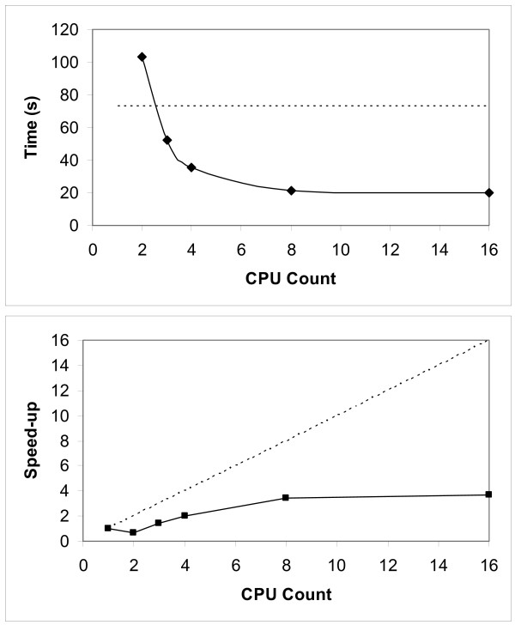
Parallel Jobs
Require understanding how well program scales

Slide 19
Parallel Jobs and Demo
Each instance (rank) of parallel job needs to be aware what its tasks are compared to the other instances (“parallel thinking”)
Some parallel jobs need “load balancing”
Typical execution line for a parallel job:
mpiexec -n 24 a.out
Inter-node communication networks determine how fast a parallel job completes
If billing is involved, need to be aware that this is typically per “core” hour and not wall time (real elapsed time)
Ten hour compute job on 10 nodes (24 cores each) = 2,400 core hours!

